Slide 1
REDUCING DEFAULTS
Innovative Lending
Through Smarter Banking
Group 5: Lizbeth Fernandez

Slide 2
Business Problem: Predicting Loan Defaults: Minimizing Financial Risks
The Challenge | Assist financial institutions in informed decision-making Reduce potential financial losses from loan defaults
Impact on Stakeholders | Financial Institutions: Face potential losses. Borrowers: Risk financial hardship and credit profile damage
Predictive Model Benefits | Identifies high-risk loan applicants. Improves lending decision accuracy (eligibility and denial)
Our Approach | Conducted exploratory data analysis for dataset validation Dataset differentiates between defaulted (1) and non-defaulted loans (0)

Slide 3
Data Exploration Summary
01
DATASET SIZE
02
STRUCTURE
03
CLASSIFICATION
04
TARGET VARIABLES
05
TOTAL DATA POINTS
255,347 record
17 Features, 1 Target Variable
Binary Target - 'Default'
0: No default on bank loan.
1: Defaulted on bank loan
18 columns

Slide 4
DATA DICTIONARY

Slide 5
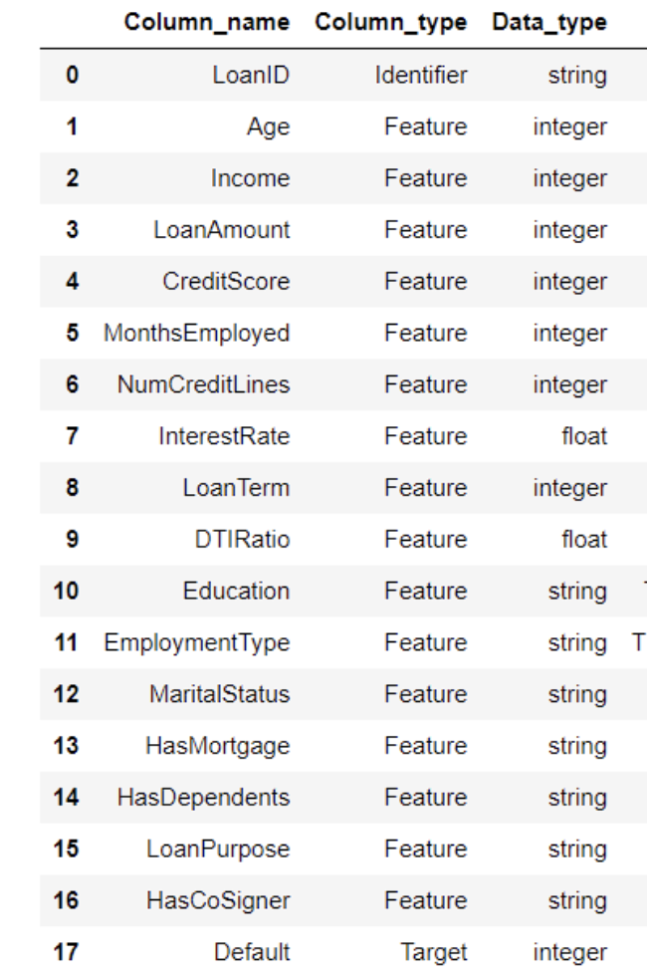

Slide 6
Comprehensive Data Dictionary PT1
NumCreditLines
HasDependents
DTIRatio
LoanPurpose
Education
HasCoSigner
Counts all active credit accounts in the borrower's name.
Shows if the borrower has financial dependents
Compares borrower's total debt to their income level.
Indicates the reason for obtaining the loan
Reflects the borrower's highest completed education degree
Signifies if another person is guaranteeing the loan repayment

Slide 7
Comprehensive Data Dictionary PT2
Column Types
Data Types
Identifiers: 1
Features: 16
Target: 1
String: 5
Integer: 9
Float: 2

Slide 8

Model Approaches
The Boosted Tree model was chosen as the best performer overall due to its superior balance of precision and recall, reflected in the highest F1 score and ROC AUC among the evaluated models.
Model | Recall | Precision | F1 | Accuracy | ROC AUC
ANN | 0.75 | 0.66 | 0.70 | 0.69 | 0.69
Boosted Tree | 0.70 | 0.67 | 0.69 | 0.68 | 0.75
XBoost | 0.70 | 0.66 | 0.68 | 0.67 | 0.74
Random Forest | 0.70 | 0.68 | 0.69 | 0.69 | 0.74
KNN | 0.64 | 0.66 | 0.65 | 0.66 | 0.71
Logistic Regression | 0.70 | 0.68 | 0.68 | 0.68 | 0.75

Slide 9
MODEL Optimization Results
Model | Recall | Precision | F1 | Accuracy | ROC AUC
Boosted Tree | 0.70 | 0.67 | 0.69 | 0.68 | 0.75341
Optimized BT | 0.70 | 0.68 | 0.69 | 0.69 | 0.75342
Logistic Regression | 0.70 | 0.68 | 0.68 | 0.68 | 0.75
Optimized LR | 0.69 | 0.67 | 0.68 | 0.68 | 0.74

Slide 10
Feature Importance
Age is the most relevant feature but since In the United States, age is considered a protected class under the Age Discrimination in Employment Act (ADEA) and other related legislation. Specifically, the Equal Credit Opportunity Act (ECOA) prohibits discrimination in any aspect of a credit transaction based on age, among other factors, therefore we will not consider it’s effects in our business appropriate.
The following three features with importance:
Interest Rate
Income
Months Employed

Slide 11
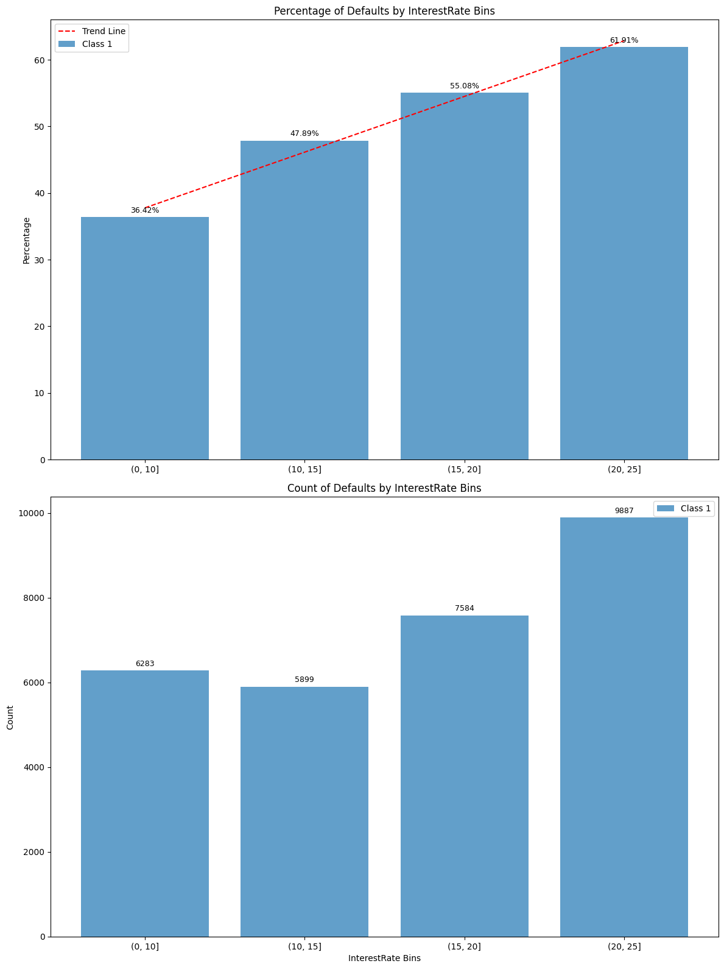
Feature Importance - Interest Rate

Slide 12
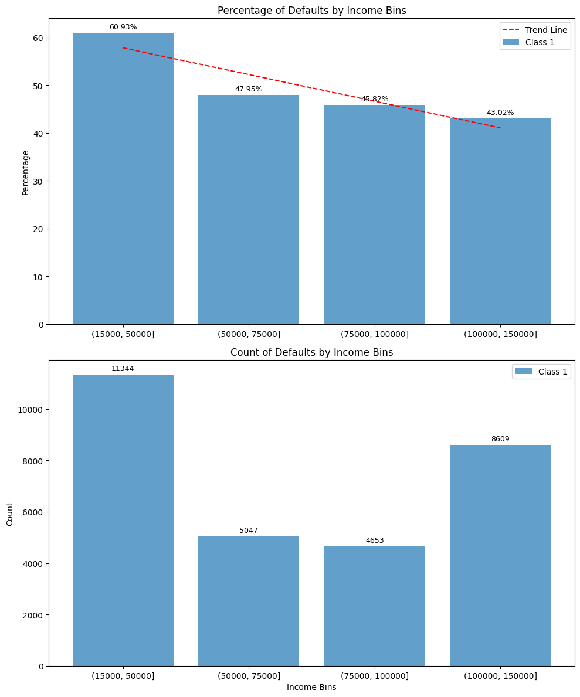
Feature Importance - Income

Slide 13
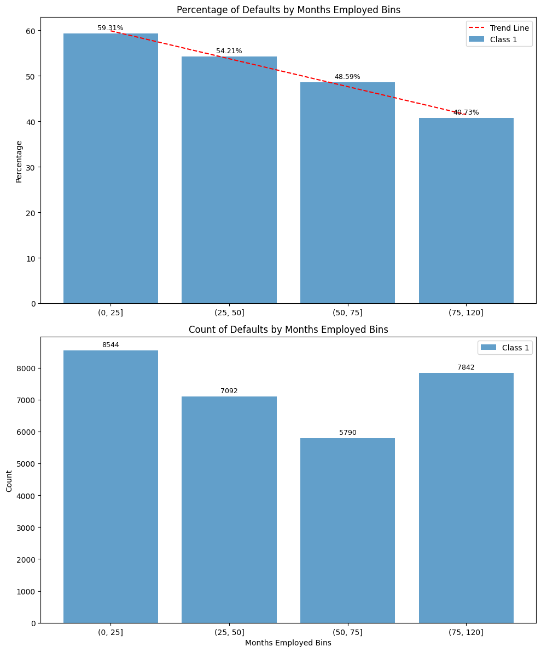
Feature Importance - Months Employed

Slide 14
Next Steps & Recommendations
Identify Customer's Likelihood of Defaulting
Integrate model insights into credit risk assessment.
Focus on high-risk indicators: high interest rates, lower income, shorter employment duration.
Identify Customer Needs
Financial Literacy Programs: Educate customers on effective financial management.
Flexible Repayment Options: Adapt loan terms to individual financial situations.
Special Loan Options for Short-term Employed Customers:
Offer a secondary loan with a lower approval amount and a slightly higher interest rate.
Provide closing cost coverage to incentivize and assist in home purchases.

Slide 15
Next Steps & Recommendations
Execute Action Plan
Implement tailored loan approval criteria and customer support initiatives.
Regularly review and adjust strategies based on performance metrics and customer feedback.
Key Takeaway: Balancing risk management with proactive customer support fosters a more sustainable and responsible banking environment.

Slide 16
THANK YOU FOR YOUR TIME

